Slide 1

Subject Name: Artificial Intelligence and Data Science
Module Number : 01
Module Name: Introduction to Artificial Intelligence

Slide 2
Introduction to Artificial Intelligence
Syllabus
Introduction to Artificial Intelligence
What is Artificial Intelligence(AI)? Brief history of AI. Intelligence and artificial intelligence. Elements of intelligence – Reasoning, Learning, Problem Solving, Perception, Linguistic, intelligence. Coming together of cognition, Philosophy, Math, Linguistic, Control Theory and Computer Science. Machine and Intelligence. The Turning Test. Limitation and possibilities of AI. Concern about AI. AI and the future.
2

Slide 3
Aim
Introduction to Artificial Intelligence
To make students understand students the concept of Artificial Intelligence , its importance and its future.

Slide 4
Objectives
Introduction to Artificial Intelligence
The Objectives of this module are:
To study AI and understand its importance .
Discussing the elements of AI.
Understanding difference between machine and intelligence.
Studying the limitations, concern and future of AI.

Slide 5
Outcomes
Introduction to Artificial Intelligence
At the end of this module you are expected to :
Understand deeply the introduction and need of developing AI.
It will be clearing all the concepts related to basics of AI.
Comparative study of now and future.
Various elements of AI and Its application will be understood.

Slide 6
Introduction to Artificial Intelligence
Contents
What is Artificial Intelligence(AI)?
Brief history of AI.
Intelligence and artificial intelligence.
Elements of intelligence – Reasoning, Learning, Problem Solving, Perception,
Linguistic and Intelligence.
Coming together of cognition, Philosophy, Math, Linguistic, Control Theory and
Computer science.
Machine and Intelligence.
The Turning Test.
Limitation and possibilities of AI.
Concern about AI.
AI and the future.

Slide 7
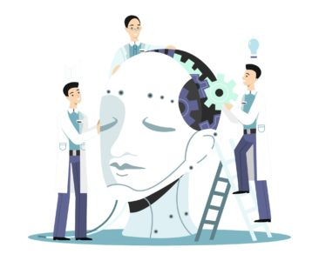
Introduction to Artificial Intelligence
What is Artificial Intelligence ?
AI is a technique that enables machines to mimic human behavior.
AI is the reproduction of human reasoning and intelligent behavior by computational
methods.
AI is to make computers do things at which at the present moment human are better.

Slide 8
Introduction to Artificial Intelligence
Definition
AI is a branch of Computer Science for the study of how to make computers do things at which, at the moment people do better.
This definition has limitations, as it is ephemeral
-- refers to the current (i.e. as on today) state of computer science and it excludes a major area; problems that cannot be solved well either by computers or by people at the moment.

Slide 9
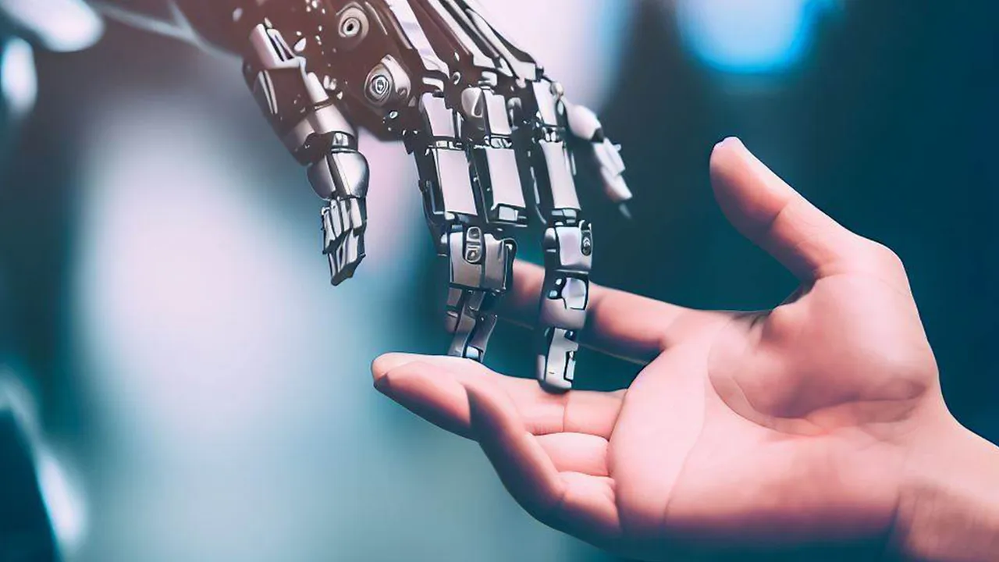
Introduction to Artificial Intelligence
What is Artificial Intelligence(AI)?
Artificial intelligence is the simulation of human intelligence processes by machines, especially computer systems. Specific applications of AI include expert systems, natural language processing, speech recognition and machine vision.
9

Slide 10
Introduction to Artificial Intelligence
AI is the branch of computer science that is concerned with the automation of intelligent behavior.
AI is based upon the principles of computer science namely data structures used in knowledge representation, the algorithms needed to apply that knowledge and the languages and programming techniques used in their implementation.
AI is a field of study that encompasses computational techniques for performing tasks that require intelligence when performed by humans.
AI is the field of study that seeks to explain and emulate intelligent behavior in terms of computational processes.
AI is the part of computer science concerned with designing intelligent computer systems, that is, computer systems that exhibit the characteristics we associate with intelligence in human behavior -- understanding language, learning, reasoning and solving problems

Slide 11
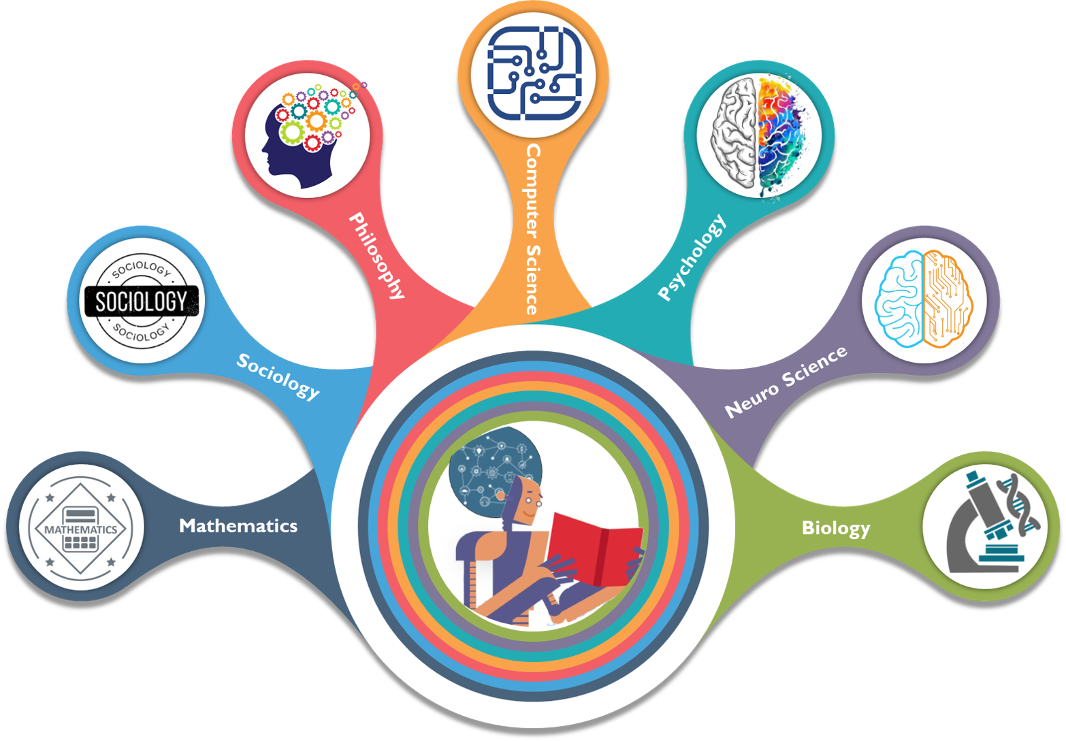
Introduction to Artificial Intelligence
AI combines various features, technologies and aspects in order to achieve a transformed and much better version of a machine.
They include:
11

Slide 12
Introduction to Artificial Intelligence
Brief history of AI.
The birth of artificial intelligence
1950: Turing‟s landmark paper “Computing machinery and intelligence” and Turing Test
1951: AI programs were developed at Manchester:
A draughts-playing program by Christopher Strachey
A chess-playing program by Dietrich Prinz
These ran on the Ferranti Mark I in 1951.
1955: Symbolic reasoning and the Logic Theorist
Allen Newell and (future Nobel Laureate) Herbert Simon created the "Logic Theorist". The program would eventually prove 38 of the first 52 theorems in Russell and Whitehead's Principia Mathematica
1956: Dartmouth Conference – The well known phrase
"Artificial Intelligence" was coined during this conference.
14
12

Slide 13
Introduction to Artificial Intelligence
In 1950, Alan Turing devised the Turing test.
1956 to 74 is called as the golden era for AI, the Wabot project in 1967 built a robot.
In the 1980s a form of AI program called Expert Systems was adopted by corporations
A new paradigm called Intelligent Agents became widely accepted during the 1990s.
In the first decades of the 21st century, access to large amounts of data, faster computers, and advanced machine learning techniques was successfully applied to many problems throughout the economy.
By 2016, the market for AI-related products, hardware, and software reached more than 8 billion dollars. Also, the New York Times reported that interest in AI had reached a turmoil.

Slide 14
Introduction to Artificial Intelligence
Intelligence:
Human intelligence or the behavior of the human being has come from past experiences and the doings based upon situation, and environment. And it is completely based upon the ability to change his/her surroundings through knowledge which we gained.
It gives diverse sorts of information. It can provide data on things related to a particular aptitude and knowledge, which can be another human subject, or, within the case of locators and spies, diplomatic data which they had to get to. So, after concluding all it can give data on interpersonal connections and arrange of interest.

Slide 15
Introduction to Artificial Intelligence
Advantages of Human Intelligence (HI):
HI has creativity, intuition, and emotional intelligence that AI lacks.
HI can adapt to new and unexpected situations.
HI can provide ethical and moral considerations in decision-making.
Disadvantages of Human Intelligence (HI):
HI is limited by its physical and mental capabilities.
HI is prone to biases and may make errors or poor decisions.
HI requires rest and breaks, which can slow down processes.

Slide 16
Introduction to Artificial Intelligence
Artificial Intelligence:
Artificial Intelligence is based on human insights that can be decided in a way that can machine can effortlessly actualize the tasks, from the basic to those that are indeed more complex. The reason for manufactured insights is learning, problem-solving, reasoning, and perception.
This term may be connected to any machines which show related to a human intellect such as examination and decision-making and increments the efficiency.
AI covers assignments like robotics, control systems, face recognition, scheduling, data mining, and numerous others.

Slide 17
Introduction to Artificial Intelligence
Advantages of Human Intelligence (HI):
AI can process vast amounts of data much faster than humans.
AI can work around the clock without needing breaks or rest.
AI can perform tasks that are too dangerous or difficult for humans.
Disadvantages of Artificial Intelligence (AI):
AI lacks the creativity and intuition that humans possess.
AI is limited by its programming and may not be able to adapt to new or unexpected situations.
AI may make errors if not programmed and trained properly.

Slide 18
Introduction to Artificial Intelligence
AI is incorporated into a variety of different types of technology
Automation. When paired with AI technologies, automation tools can expand the volume and types of tasks performed. An example is robotic process automation (RPA), a type of software that automates repetitive, rules-based data processing tasks traditionally done by humans. When combined with machine learning and emerging AI tools, RPA can automate bigger portions of enterprise jobs, enabling RPA's tactical bots to pass along intelligence from AI and respond to process changes.
Machine learning. This is the science of getting a computer to act without programming. Deep learning is a subset of machine learning that, in very simple terms, can be thought of as the automation of predictive analytics. There are three types of machine learning algorithms:
Supervised learning. Data sets are labeled so that patterns can be detected and used to label new data sets.
Unsupervised learning. Data sets aren't labeled and are sorted according to similarities or differences.
Reinforcement learning. Data sets aren't labeled but, after performing an action or several actions, the AI system is given feedback.
18

Slide 19
Introduction to Artificial Intelligence
Machine vision. This technology gives a machine the ability to see. Machine vision captures and analyzes visual information using a camera, analog-to-digital conversion and digital signal processing. It is often compared to human eyesight, but machine vision isn't bound by biology and can be programmed to see through walls, for example. It is used in a range of applications from signature identification to medical image analysis. Computer vision, which is focused on machine-based image processing, is often conflated with machine vision.
Natural language processing (NLP). This is the processing of human language by a computer program. One of the older and best-known examples of NLP is spam detection, which looks at the subject line and text of an email and decides if it's junk. Current approaches to NLP are based on machine learning. NLP tasks include text translation, sentiment analysis and speech recognition.
Robotics. This field of engineering focuses on the design and manufacturing of robots. Robots are often used to perform tasks that are difficult for humans to perform or perform consistently. For example, robots are used in car production assembly lines or by NASA to move large objects in space. Researchers also use machine learning to build robots that can interact in social settings.
19
Notes:
Image Source: https://purplegriffon.com/blog/10-cyber-security-threats-in-2017
19

Slide 20
Introduction to Artificial Intelligence
Self-driving cars. Autonomous vehicles use a combination of computer vision, image recognition and deep learning to build automated skills to pilot a vehicle while staying in a given lane and avoiding unexpected obstructions, such as pedestrians.
Text, image and audio generation. Generative AI techniques, which create various types of media from text prompts, are being applied extensively across businesses to create a seemingly limitless range of content types from photorealistic art to email responses and screenplays.
20
Notes:
20

Slide 21
Introduction to Artificial Intelligence
Application of AI
Artificial intelligence has made its way into a wide variety of markets.
AI in healthcare. The biggest bets are on improving patient outcomes and reducing costs. Companies are applying machine learning to make better and faster medical diagnoses than humans. One of the best-known healthcare technologies is IBM Watson. It understands natural language and can respond to questions asked of it.
AI in business. Machine learning algorithms are being integrated into analytics and customer relationship management (CRM) platforms to uncover information on how to better serve customers.
AI in education. AI can automate grading, giving educators more time for other tasks. It can assess students and adapt to their needs, helping them work at their own pace. AI tutors can provide additional support to students, ensuring they stay on track.
AI in finance. AI in personal finance applications, such as Intuit Mint or TurboTax, is disrupting financial institutions. Applications such as these collect personal data and provide financial advice.
AI in law. The discovery process -- sifting through documents -- in law is often overwhelming for humans. Using AI to help automate the legal industry's labor-intensive processes is saving time and improving client service. Law firms use machine learning to describe data and predict outcomes, computer vision to classify and extract information from documents, and NLP to interpret requests for information.
21
Notes:
Image Source: https://www.clickssl.net/blog/cyber-security-intelligence-with-threat-management
21

Slide 22
Introduction to Artificial Intelligence
AI in entertainment and media. The entertainment business uses AI techniques for targeted advertising, recommending content, distribution, detecting fraud, creating scripts and making movies. Automated journalism helps newsrooms streamline media workflows reducing time, costs and complexity.
AI in software coding and IT processes. New generative AI tools can be used to produce application code based on natural language prompts, but it is early days for these tools and unlikely they will replace software engineers soon. AI is also being used to automate many IT processes, including data entry, fraud detection, customer service, and predictive maintenance and security.
AI in manufacturing. Manufacturing has been at the forefront of incorporating robots into the workflow. For example, the industrial robots that were at one time programmed to perform single tasks and separated from human workers, increasingly function as cobots
AI in banking. Banks are successfully employing chatbots to make their customers aware of services and offerings and to handle transactions that don't require human intervention. Banking organizations use AI to improve their decision-making for loans, set credit limits and identify investment opportunities.
AI in transportation. In addition to AI's fundamental role in operating autonomous vehicles, AI technologies are used in transportation to manage traffic, predict flight delays, and make ocean shipping safer and more efficient.

Slide 23
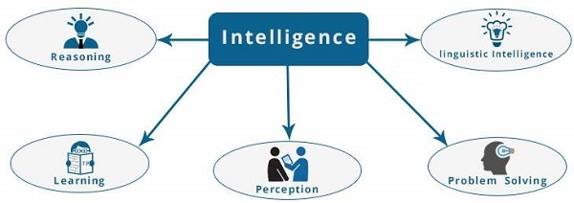
Elements of intelligence– Reasoning, Learning, Problem Solving, Perception, Linguistic, intelligence.

Slide 24
Reasoning − It is the set of processes that enables us to provide basis for judgement, making decisions, and prediction. There are broadly two types −
Inductive Reasoning | Deductive Reasoning
It conducts specific observations to makes broad general statements. | It starts with a general statement and examines the possibilities to reach a specific, logical conclusion.
Even if all of the premises are true in a statement, inductive reasoning allows for the conclusion to be false. | If something is true of a class of things in general, it is also true for all members of that class.
Example − "Nita is a teacher. Nita is studious. Therefore, All teachers are studious." | Example − "All women of age above 60 years are grandmothers. Shalini is 65 years. Therefore, Shalini is a grandmother."

Slide 25
Learning − It is the activity of gaining knowledge or skill by studying, practising, being taught, or experiencing something. Learning enhances the awareness of the subjects of the study.
The ability of learning is possessed by humans, some animals, and AI-enabled systems. Learning is categorized as −
Auditory Learning − It is learning by listening and hearing. For example, students listening to recorded audio lectures.
Episodic Learning − To learn by remembering sequences of events that one has witnessed or experienced. This is linear and orderly.
Motor Learning − It is learning by precise movement of muscles. For example, picking objects, Writing, etc.
Observational Learning − To learn by watching and imitating others. For example, child tries to learn by mimicking her parent.

Slide 26
Problem Solving − It is the process in which one perceives and tries to arrive at a desired solution from a present situation by taking some path, which is blocked by known or unknown hurdles.
Problem solving also includes decision making, which is the process of selecting the best suitable alternative out of multiple alternatives to reach the desired goal are available.
Perception − It is the process of acquiring, interpreting, selecting, and organizing sensory information.
Perception presumes sensing. In humans, perception is aided by sensory organs. In the domain of AI, perception mechanism puts the data acquired by the sensors together in a meaningful manner.
Linguistic Intelligence − It is one’s ability to use, comprehend, speak, and write the verbal and written language. It is important in interpersonal communication.

Slide 27
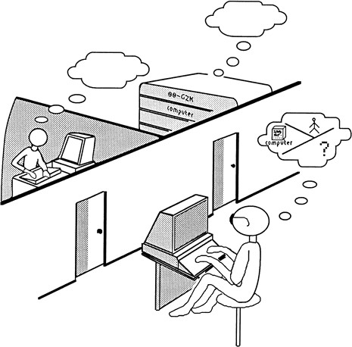
Turing Test
http://plato.stanford.edu/entries/turing-test/
Test proposed by Alan Turing in 1950
The computer is asked questions by a human
interrogator. It passes the test if the interrogator cannot tell whether the responses come from a person
Required capabilities: natural language processing, knowledge representation, automated reasoning, learning,...

Slide 28
Concerns
Lack of transparency : Lack of transparency in AI systems, particularly in deep learning models that can be complex and difficult to interpret, is a pressing issue. This opaqueness obscures the decision-making processes and underlying logic of these technologies.
Bias & Discrimination : AI systems can inadvertently perpetuate or amplify societal biases due to biased training data or algorithmic design. To minimize discrimination and ensure fairness, it is crucial to invest in the development of unbiased algorithms and diverse training data sets.
Privacy Concerns : AI technologies often collect and analyze large amounts of personal data, raising issues related to data privacy and security. To mitigate privacy risks, we must advocate for strict data protection regulations and safe data handling practices.

Slide 29
Ethical Dilemmas
Instilling moral and ethical values in AI systems, especially in decision-making contexts with significant consequences, presents a considerable challenge. Researchers and developers must prioritize the ethical implications of AI technologies to avoid negative societal impacts.
5. Security Risks
As AI technologies become increasingly sophisticated, the security risks associated with their use and the potential for misuse also increase. Hackers and malicious actors can harness the power of AI to develop more advanced cyberattacks, bypass security measures, and exploit vulnerabilities in systems.
The rise of AI-driven autonomous weaponry also raises concerns about the dangers of rogue states or non-state actors using this technology — especially when we consider the potential loss of human control in critical decision-making processes. To mitigate these security risks, governments and organizations need to develop best practices for secure AI development and deployment and foster international cooperation to establish global norms and regulations that protect against AI security threats.

Slide 30
6. Concentration of Power
The risk of AI development being dominated by a small number of large corporations and governments could exacerbate inequality and limit diversity in AI applications. Encouraging decentralized and collaborative AI development is key to avoiding a concentration of power.
7. Dependence on AI
Overreliance on AI systems may lead to a loss of creativity, critical thinking skills, and human intuition. Striking a balance between AI-assisted decision-making and human input is vital to preserving our cognitive abilities.
8. Job Displacement
AI-driven automation has the potential to lead to job losses across various industries, particularly for low-skilled workers (although there is evidence that AI and other emerging technologies will create more jobs than it eliminates).
As AI technologies continue to develop and become more efficient, the workforce must adapt and acquire new skills to remain relevant in the changing landscape. This is especially true for lower-skilled workers in the current labor force.

Slide 31
9. Economic Inequality
AI has the potential to contribute to economic inequality by disproportionally benefiting wealthy individuals and corporations. As we talked about above, job losses due to AI-driven automation are more likely to affect low-skilled workers, leading to a growing income gap and reduced opportunities for social mobility.
10. Legal and Regulatory Challenges
It’s crucial to develop new legal frameworks and regulations to address the unique issues arising from AI technologies, including liability and intellectual property rights. Legal systems must evolve to keep pace with technological advancements and protect the rights of everyone.
11. Loss of Human Connection
Increasing reliance on AI-driven communication and interactions could lead to diminished empathy, social skills, and human connections. To preserve the essence of our social nature, we must strive to maintain a balance between technology and human interaction.

Slide 32
AI and future
As a result of artificial intelligence technology, the software is capable of performing human functions, such as planning, reasoning, communication, and perception, more effectively, efficiently, and at a lower cost. Artificial intelligence speeds up, improves precision, and increases the efficacy of human endeavors. To predict fraudulent transactions, implement rapid and accurate credit scoring, and automate labor-intensive tasks in data administration, financial institutions can use artificial intelligence approaches.
Artificial intelligence plays a significant role in virtually every field of human endeavor. It is already the primary driver of developing technologies such as big data, robots, and the Internet of Things, and it will continue to be a technical pioneer in the foreseeable future.

